Slide 1
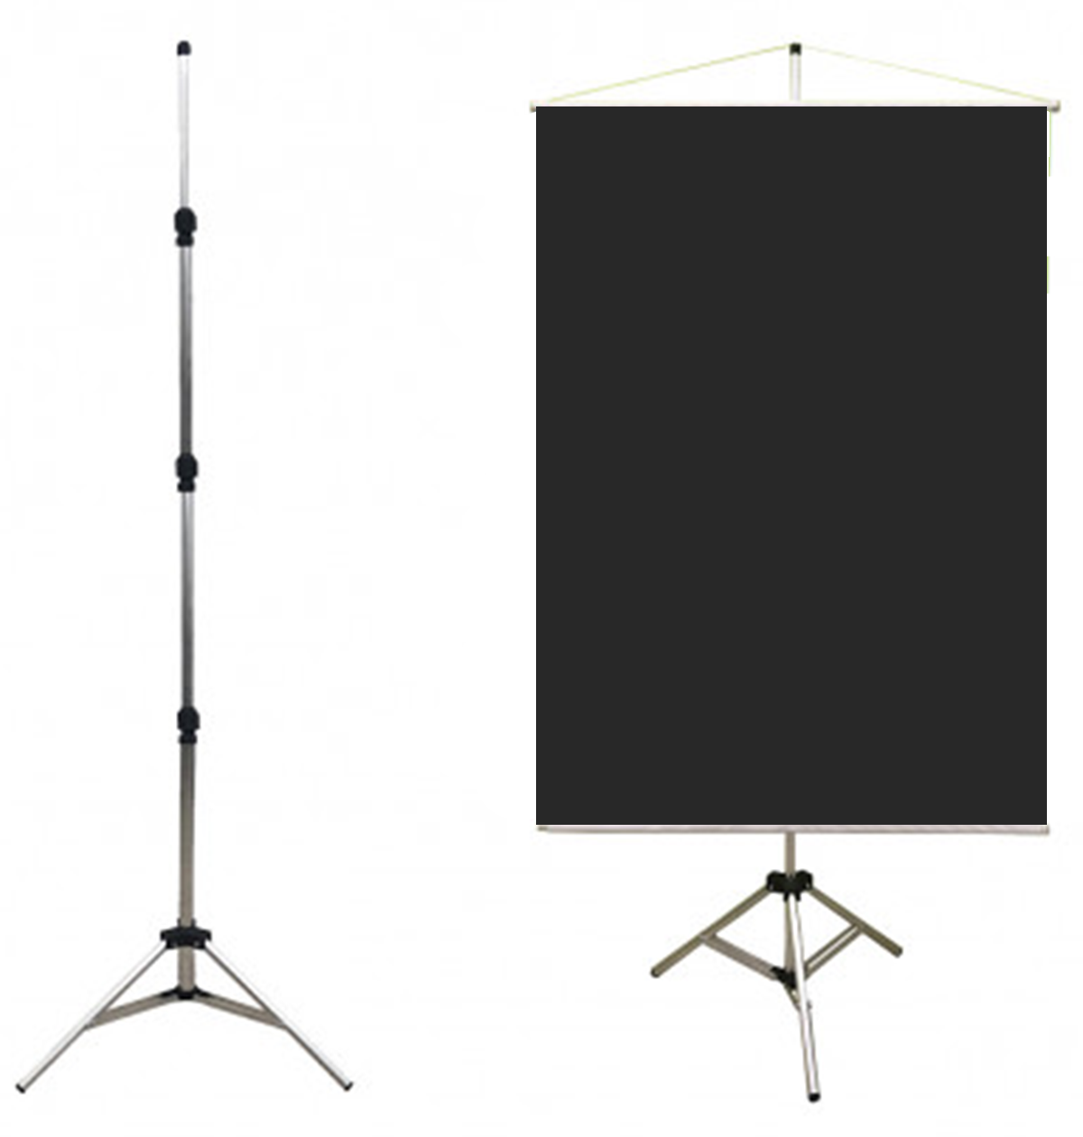
PAPER TITLE PAPER TITLE PAPER TITLE PAPER TITLE
Author Name¹, Author Name², Author Name³, …
¹ Author(s) Affiliation, ² Author(s) Affiliation, ^{3,4,5} Author(s) Affiliation
Author¹ e-mail, Author² e-mail, Author³ e-mail, …
INTRODUCTION
RESULTS
This poster template is provided as a sample only. You may change the layout of your poster if you like.
The following are guidelines recommended by COBEP/SPEC 2023 for all presentations to follow:
Recommended Guidelines
Font should be sans serif type like Verdana or Tahoma
Headings should be 48pt or larger
Text should be 28pt or larger
The smallest text size in figures and tables should be 24pt
The size of the poster is 90cm by 120cm in portrait orientation.
The structure for the poster support provided will follow the model shown in the image. The poster needs to have a structure and a cord for attachment.
The following are guidelines recommended by COBEP/SPEC 2023 for all presentations to follow:
Recommended Guidelines
Font should be sans serif type like Verdana or Tahoma
Headings should be 48pt or larger
Text should be 28pt or larger
The smallest text size in figures and tables should be 24pt
The size of the poster is 90cm by 120cm in portrait orientation.
The structure for the poster support provided will follow the model shown in the image. The poster needs to have a structure and a cord for attachment.
METHODOLOGY
The following are guidelines recommended by COBEP/SPEC 2023 for all presentations to follow:
Recommended Guidelines
Font should be sans serif type like Verdana or Tahoma
Headings should be 48pt or larger
Text should be 28pt or larger
The smallest text size in figures and tables should be 24pt
The size of the poster is 90cm by 120cm in portrait orientation.
The structure for the poster support provided will follow the model shown in the image. The poster needs to have a structure and a cord for attachment.
CONCLUSION
The following are guidelines recommended by COBEP/SPEC 2023 for all presentations to follow:
Recommended Guidelines
Font should be sans serif type like Verdana or Tahoma
Headings should be 48pt or larger
Text should be 28pt or larger
The smallest text size in figures and tables should be 24pt
The size of the poster is 90cm by 120cm in portrait orientation.
The structure for the poster support provided will follow the model shown in the image. The poster needs to have a structure and a cord for attachment.
REFERENCES
The following are guidelines recommended by COBEP/SPEC 2023 for all presentations to follow:
Recommended Guidelines
Font should be sans serif type like Verdana or Tahoma
Headings should be 48pt or larger
Text should be 28pt or larger
The smallest text size in figures and tables should be 24pt
The size of the poster is 90cm by 120cm in portrait orientation.
The structure for the poster support provided will follow the model shown in the image. The poster needs to have a structure and a cord for attachment.

